Slide 1

5. Data Clustering

Slide 2
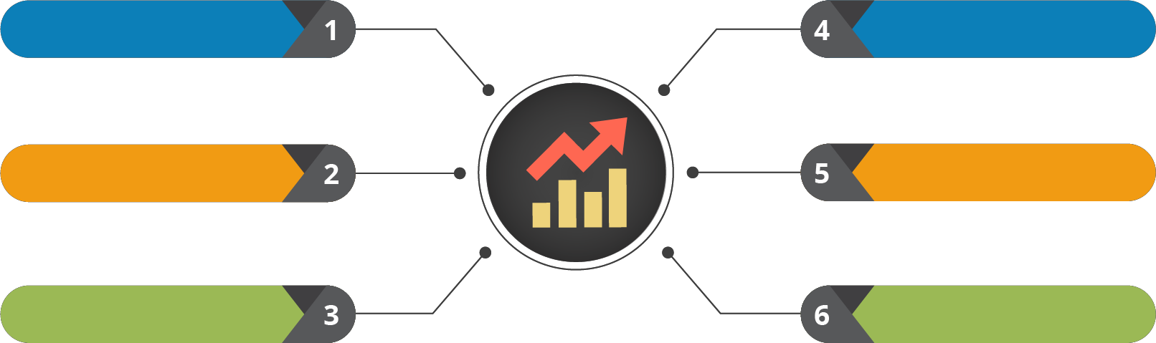

Course Outline
Understanding the Data
Testing the Data
Probability and its uses
Data Clustering
Statistical Inference
Regression Modelling

Slide 3

Course Objectives
After completing this module, you should be able to:
Association & Dépendance
Causation & Corrélation
Covariance
Simpsons Paradox
Clustering Techniques

Slide 4


1. Association & Dependence

Slide 5
Association & Dependence
Let’s begin by understanding the concept of Association and Dependence

Slide 6

What is Association/Dependence?
In statistics, dependence or association is any statistical relationship, whether causal or not, between two random variables or bivariate data
An Association rule is a pattern that states when an event occurs, another event occurs with a certain probability
In Data Science, Association rule mining is a popular and well researched method for discovering
interesting relations between variables in large databases
Example:
Customers who purchase keyboard have a 60% likelihood of also purchasing mouse for their PC
Customers who purchases a mobile are very likely to purchase a case or cover
Such information can be used as the basis for decisions about marketing activities such as, promotional pricing
or product placements

Slide 7

Let’s discuss a few parameters causing Association and Dependence

Slide 8
2. Causation, Corrélation &
Covariance

Slide 9
Causation, Correlation & Covariance
Let’s begin by understanding the concept of Causation, Correlation and Covariance

Slide 10
Causation
Causation indicates that one event is the result of the occurrence of the other event. This is also referred to as cause and effect
Alcoholism
Alcohol can cause increase in risk of developing cancer
Smoking
Smoking can cause increase in risk of developing cancer
Cancer

Slide 11
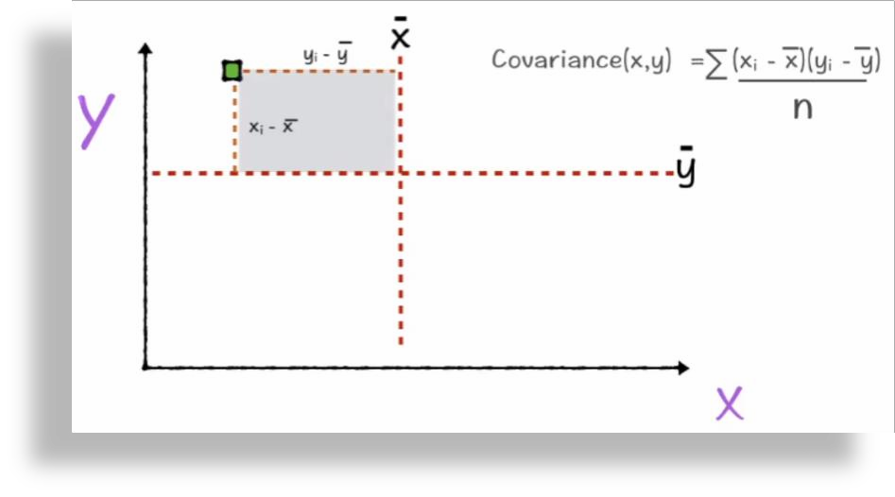


Covariance
Covariance is variance in 2 dimensions
Where x represents mean of x
and y represents mean of y
n is total number of entries

Slide 12
Computing Covariance
n
X )( y_{i} − Y )
∑(x_{i}
cov(x , y) = ^{i=1}
n −1

Slide 13




Correlation
Determines both the nature and strength of relationship between two variables
Positive
Correlation
Range of Correlation
+1
Negative
Correlation
-1
Note: Correlation is applied only when the variables are dependent on time

Slide 14
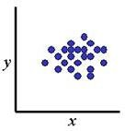
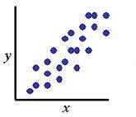
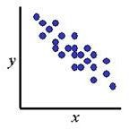
Covariance and Correlation
cov(X,Y) = 0: X and Y are
independent
cov(X,Y) > 0: X and Y are positively correlated
cov(X,Y) < 0: X and Y are inversely correlated

Slide 15


Correlation Coefficient
Pearson’s Correlation Coefficient is standardized covariance
𝐶𝑜𝑣𝑎𝑟𝑖𝑎𝑛𝑐𝑒(x, y)
𝑉𝑎𝑟𝑥 𝑉𝑎𝑟𝑦
r
=

Slide 16





















































Scatter Plots with Various Correlation Coefficients
Y
Y Y
X
X
X
r = -.6
r = 0
r = -1
Y
Y
Y
X
X
X
r = +1
r = +.3
r = 0

Slide 17
Let’s calculate Correlation Coefficient using Python

Slide 18
Scenario
Following is a sample dataset
‘mtcars_for_manymerge’ containing the variables:
Cars
mpg for Mileage Per Gallon
cyl for cylinder
disp for displacement
hp for horsepower and
drat for real axle ratio
Cars | mpg | cyl | disp | hp | drat
MazdaRX4 | 21 | 6 | 160 | 110 | 3.9
MazdaRX4_WAG | 21 | 6 | 160 | 110 | 3.9
Datsun_710 | 22.8 | 4 | 108 | 93 | 3.85
Hornet_4_Drive | 21.4 | 6 | 258 | 110 | 3.08
Hornet_Sportabout | 18.7 | 8 | 360 | 175 | 3.15
Valiant | 18.1 | 6 | 225 | 105 | 2.76
Duster_360 | 14.3 | 8 | 360 | 245 | 3.21
Merc_240D | 24.4 | 4 | 146.7 | 62 | 3.69
Merc_230 | 22.8 | 4 | 140.8 | 95 | 3.92
Merc_280 | 19.2 | 6 | 167.6 | 123 | 3.92

Slide 19
Correlation – Tasks To Do
Consider the dataset mtcars_for_manymerge
01
01
Tasks
02
Extract two variables
02
03
Determine the correlation between them
03

Slide 20
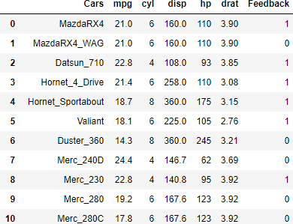
Step 1: Import Module & Load the Dataset
import pandas as pd
df = pd.read_csv('mtcars_for_manymerge.csv') print (df)

Slide 21


Step 02: Extract the Variables
x = df['hp']
y = df['cyl’]
print(x)
x = df['hp']
y = df['cyl’] print(y)

Slide 22
Step 03: Determine the Correlation
x.corr(y)
We can infer that the ‘hp’ and ‘cyl’ variables are highly correlated with
each other with a correlation factor of 0.92

Slide 23
3. Simpsons Paradox

Slide 24
Simpson Paradox
Let’s begin by understanding the concept of Simpson Paradox

Slide 25

Let’s take an example, You want to get your eyes operated, but you are afraid
because chances of failure in the
particular procedure are high
You decided to use statistics to make your decisions, let’s see how that goes

Slide 26


A Scenario
The Data available is as follows:
 | Doctor A | Doctor B
Period 1 | 63/90 = 70% | 9/10 = 90%
Period 2 | 4/10 = 40% | 45/90 = 50%
Total | 67/100 = 67% | 54/100 = 54%
Why???
From the table we can see that during both period 1 and 2 respectively, Doctor B had higher success rates as compared to doctor A, but the total shows Doctor A has higher success rate. Clearly we have a conflict

Slide 27
The Simpson’s Paradox
 | Doctor A | Doctor B
Period 1 | 63/90 ^{= 70%} | 9/10 = 90%
Period 2 | 4/10 = 40% | 45/90 = 50%
Total | 67/100 = 67% | 54/100 = 54%
Answer is that we are not comparing the same thing
During period 1, we compared 90 event to 10 events
Similarly during period 2, we compared 10 events to 90 events
This is why the Simpson’s paradox occurs

Slide 28

Simpson’s Paradox – When?
Occurs when groups of data show one
particular trend
The trend is reversed when the groups are combined together
Understanding this paradox is important for correctly interpreting data

Slide 29
Simpson’s Paradox – Mathematically
Consider ’n’ groups of data such that ‘I’ group has 𝐴_{𝑖} trials and 0 ≤ 𝑎_{𝑖} ≤ 𝐴_{𝑖} "successes"
Similarly, consider an analogous group ‘I’ has _{𝐵𝑖} trials and _{0 ≤ 𝑏𝑖 ≤ 𝐵𝑖} "successes"
Then, Simpson’s Paradox occurs if:
_{σ}𝑛 _{σ}𝑛
𝑎
𝑏_{𝑖}
𝐵
𝑎_{𝑖}
𝐴_{𝑖}
𝑏_{𝑖}
𝐵_{𝑖}
▪
𝑖
𝐴_{𝑖}
≤
for all i = 1, 2, ……, n but
𝑖=1
≥
𝑖=1
_{σ}𝑛
_{σ}𝑛
𝑖
𝑖=1
𝑖=1
Note: At least one of the inequalities is strict (meaning that it is not in the equality case)

Slide 30
4. Clustering

Slide 31
Clustering
Let’s begin by understanding the concept of Clustering

Slide 32
Clustering Techniques
₄th
₃rd
Most statistical methods for clustering and segmentation use common mathematical measures of distance (Euclidean Distance)
₂nd
Define similarity measure, we group the data points together based upon similarity
₁st
Select segmentation variables, basically the variable based upon which clustering will happen
Confirm the data is metric, as clustering can be only done based upon metric data

Slide 33


Euclidian Distance
The Euclidean Distance or Euclidean metric is the "ordinary" distance between two points in space
𝑛
෍ 𝑏_{𝑖} − 𝑎_{𝑖}
𝑖=1
D (a, b) =
2
A
B
Clusters are assigned based on the measure of Euclidean Distance

Slide 34
Cluster Assignment
Clusters are assigned to observations based on inter and intra cluster distances
Single Linkage
Distance between two clusters is the shortest distance between any two members
Complete Linkage
Distance between two clusters is the longest distance between any two members
Average Linkage
Distance between two clusters is the average distance between all pairs of
two cluster’s members
Centroid Linkage
Distance between two clusters equals the distance between two centroids

Slide 35

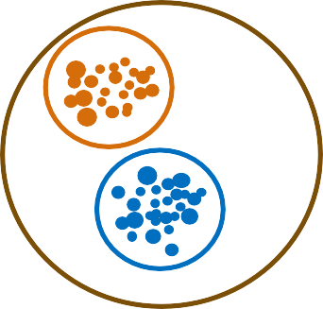
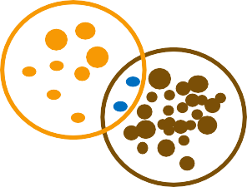
Classification of Clustering
Clustering
Exclusive Clustering
Overlapping Clustering
Hierarchical Clustering
Here, an item belongs exclusively to one cluster, not several. K- means does this sort of exclusive clustering
Here, an item can belong to multiple clusters and its degree of association with each cluster is shown. Fuzzy/c-means is of this type
When two cluster have a parent- child relationship or a tree-like structure then it is Hierarchical
clustering
Cl2
Cluster 0
Cl1
Cl0
Cluster 0
Cluster 1
Cluster 2
Cluster 1
Cluster 1
Cluster 2
Cluster 2

Slide 36
K-means Clustering

Slide 37
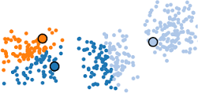
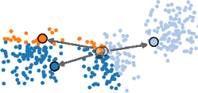
K – Means Clustering
Applies when number of observations>100
Implemented using the following algorithm:
Objects are randomly partitioned into k non empty clusters
Centroid for each cluster is calculated
Observations are assigned to different clusters based on their difference from all centroids
The third step is iterated till the assignment changes
Stop, when the assignment will not change further

Slide 38



How K-Means Clustering Works?
Initialization
Randomly initialize k points called the cluster centroids.
Here, k = 2
Cluster Assignment
Value of k (optimal number of clusters) can be determined by the elbow curve
Move Centroid
Optimization
Y-axis
Convergence
Cluster centroid
X-axis

Slide 39

How K-Means Clustering Works?
Initialization
Compute the distance between the data points and the cluster centroid(s).
Depending upon the minimum distance, data points are divided into two groups (since k=2 in this case).
Cluster Assignment
Move Centroid
Optimization Convergence
Y-axis
X-axis

Slide 40

How K-Means Clustering Works?
Initialization
Compute the mean of blue dots
Reposition blue cluster centroid to this mean
Cluster Assignment
Compute the mean of orange dots
Move Centroid
Reposition orange cluster centroid to this mean
Optimization
Convergence
Y-axis
X-axis

Slide 41

How K-Means Clustering Works?
Initialization
Repeat previous two steps iteratively till the cluster centroids stop changing
their positions
Cluster Assignment
Move Centroid Optimization Convergence
Y-axis
X-axis

Slide 42
How K-Means Clustering Works?
Initialization
Finally clustering algorithm converges
Divides the data points into two clusters clearly visible in orange and blue
Cluster Assignment
Move Centroid Optimization Convergence
Y-axis
X-axis

Slide 43

How to Find Optimal Solution?
Idea 1: Careful about where we start
Choose first center at random
Choose second center that is far away from the first center
Choose j^{th} center as far away as possible from the closest of centers 1 through (j-1)
Idea 2: Do many runs of clustering, each with different random starting point
Where you begin is important

Slide 44


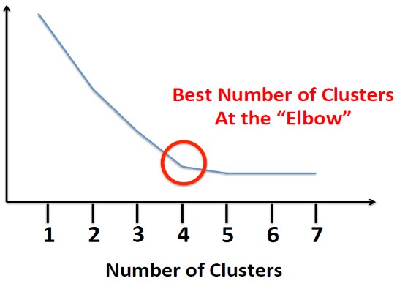
Choosing the Number of Clusters
The Elbow Method
Objective Function Value i.e., Distortion

Slide 45

Let’s implement K - Means Clustering using Python

Slide 46



Tasks To Do
Define two variables x and y with different set of values
01
02
Construct an array with the set of two variables and apply k means clustering, where k =2
03
Plot the clustered output

Slide 47
Step 01: Import the Modules
import numpy as np
import matplotlib.pyplot as plt from matplotlib import style style.use("ggplot")
from sklearn.cluster import KMeans

Slide 48
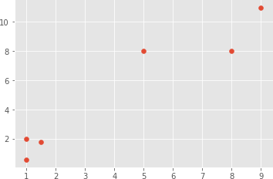
Step 02: Define your Data and Plot the Same
x = [1, 5, 1.5, 8, 1, 9]
y = [2, 8, 1.8, 8, 0.6, 11]
plt.scatter(x,y)
plt.show()

Slide 49
Step 03: Convert your Data into Numpy Array
X = np.array([[1, 2],[5, 8],[1.5, 1.8],
[8, 8],[1, 0.6],[9, 11]])
Note: Data is converted because a NumPy array of features is what Scikit-learn expects

Slide 50

Step 04: Apply the K Means Method
kmeans = KMeans(n_clusters=2)
kmeans.fit(X)
centroids = kmeans.cluster_centers_ labels = kmeans.labels_
print(centroids) print(labels)

Slide 51

Step 05: Plot and Visualize the Machine Findings
colors = ["g.","r.","c.","y."]
for i in range(len(X)):
print("coordinate:",X[i], "label:", labels[i])
plt.plot(X[i][0], X[i][1], colors[labels[i]], markersize = 10)
plt.scatter(centroids[:, 0],centroids[:, 1], marker = "x", s=150, linewidths = 5, zorder = 10)
plt.show()

Slide 52
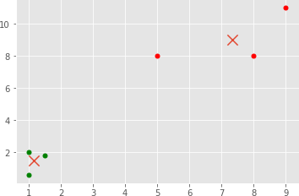
The Clustered Output Data

Slide 53
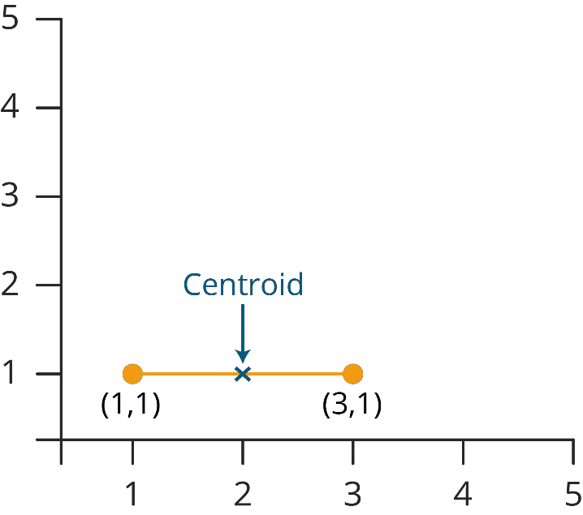
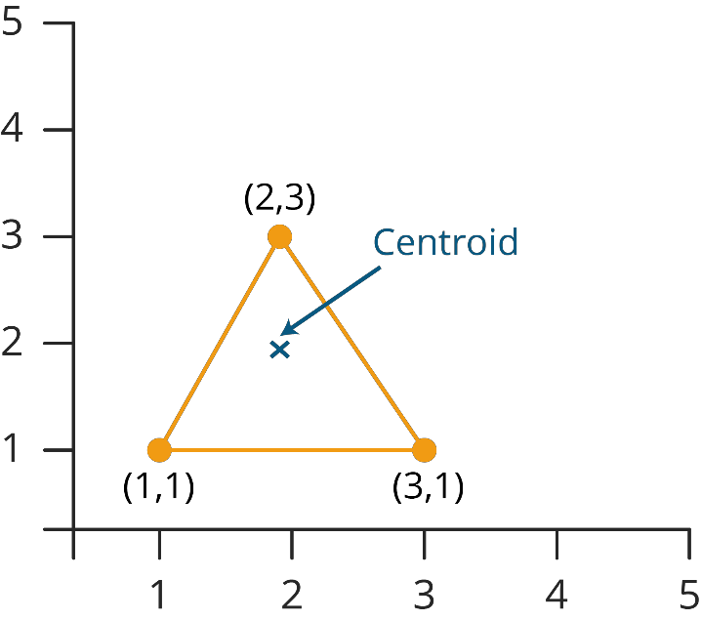
Dynamic Clustering
The point to be noted over here is, the grouping is dynamic in nature, because as soon as the new data or
values come to picture, the centroid is recalculated and shifted to the new location accordingly
Upon of new data point(2,3) in this case centroid shifts

Slide 54
Hierarchical Clustering

Slide 55


Hierarchical Clustering
Applies usually when number of observations<100
Two kinds of approach used : Agglomerative and
Divisive
The Agglomerative approach starts with each observation as a cluster and with each step combines observations to form clusters until there is only one large cluster
The Divisive approach begins with one large cluster and split into smaller clusters that are most dissimilar
Large Single Cluster
Agglomerative
Divisive
Smallest Clusters

Slide 56



Optimum Number of Clusters in Hierarchical Clustering
The Dendogram so obtained gives you a picture of how clusters are formed within each step
The height along the y-axis represents the inter-cluster distance
Split the dendogram along the height, from the point, where
there is abrupt increase in inter-cluster distance
Count the number of lines you cross along the split
Lines thus obtained are the optimum number of clusters formed
Represent the number of optimum clusters

Slide 57
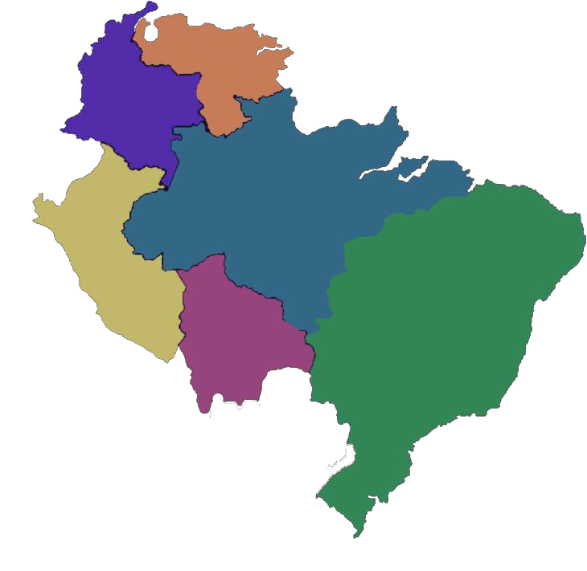







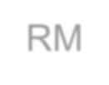












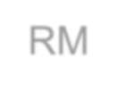



Hierarchical Clustering Example
A Hierarchical Clustering of distances in kilometers between some cities
MI
TO
FI
RM
NA
BA
BA
NA RM
FI TO MI

Slide 58
Hierarchical Clustering Step -1
First step is to create distance matrix of your data
 | BA | FI | MI |  | NA | RM | TO
BA | 0 | 662 | 877 |  | 255 | 412 | 996
FI | 662 | 0 | 295 |  | 468 | 268 | 400
MI | 877 | 295 | 0 |  | 754 | 564 | 138
NA | 255 | 468 | 754 |  | 0 | 219 | 869
RM | 412 | 268 | 564 |  | 219 | 0 | 669
TO | 996 | 400 | 138 |  | 869 | 669 | 0
Distance between TO and MI
Distance Matrix

Slide 59




Hierarchical Clustering Step -2
From the distance matrix you can see that MI has least distance with TO, they’ll form the cluster together
 | BA | FI | MI | NA | RM | TO
BA | 0 | 662 | 877 | 255 | 412 | 996
FI | 662 | 0 | 295 | 468 | 268 | 400
MI | 877 | 295 | 0 | 754 | 564 | 138
NA | 255 | 468 | 754 | 0 | 219 | 869
RM | 412 | 268 | 564 | 219 | 0 | 669
TO | 996 | 400 | 138 | 869 | 669 | 0
 | BA | FI |  | NA | RM
BA | 0 | 662 |  | 255 | 412
FI | 662 | 0 |  | 468 | 268
NA | 255 | 468 |  | 0 | 219
RM | 412 | 268 |  | 219 | 0
MI/TO
877
295
0
754
564
MI/TO 877 295 754 564
TO MI

Slide 60





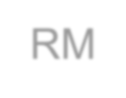


Hierarchical Clustering Step - 3
min d(i,j) = d(NA,RM) = 219 => merge NA and RM into a new cluster called NA/RM. L(NA/RM) = 219
 | BA | FI | MI/TO | NA | RM
BA | 0 | 662 | 877 | 255 | 412
FI | 662 | 0 | 295 | 468 | 268
MI/TO | 877 | 295 | 0 | 754 | 564
NA | 255 | 468 | 754 | 0 | 219
RM | 412 | 268 | 564 | 219 | 0
 | BA | FI |  | MI/TO | NA/RM
BA | 0 | 662 |  | 877 | 255
FI | 662 | 0 |  | 295 | 268
MI/TO | 877 | 295 |  | 0 | 564
NA/RM | 255 | 268 |  | 564 | 0
NA RM TO MI

Slide 61







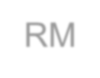


Hierarchical Clustering Step - 4
The clustering will keep on happening, till you get a single cluster with all members within it
 | BA | FI | MI/TO | NA/RM
BA | 0 | 662 | 877 | 255
FI | 662 | 0 | 295 | 268
MI/TO | 877 | 295 | 0 | 564
NA/RM | 255 | 268 | 564 | 0
BA NA RM TO MI
 |  | FI | MI/TO
FI |  | 0 | 295
MI/TO |  | 295 | 0
BA/(NA/RM)
0
268
564
BA/(NA/RM) 268 564

Slide 62







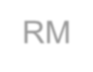



Hierarchical Clustering Step - 5
The clustering will keep on happening, till you get a single cluster with all members within it
 | BA/(NA/RM) | FI | MI/TO
BA/(NA/RM) | 0 | 268 | 564
FI | 268 | 0 | 295
MI/TO | 564 | 295 | 0
BA
NA RM FI TO MI
 | BA/(NA/RM)/FI
BA/(NA/RM)/FI | 0
(MI/TO)
295
0
(MI/TO) 295

Slide 63
Hierarchical Clustering Step - 6
Finally, you will get a Dendrogram as,
 | BA/(NA/RM)/FI | (MI/TO)
BA/(NA/RM)/FI | 0 | 295
(MI/TO) | 295 | 0
BA
NA RM FI TO MI

Slide 64
Let’s understand Hierarchical Clustering with the help of Python

Slide 65
Scenario
Following is a sample dataset of mtcars
cars | mpg | cyl | disp | hp | drat | wt | qsec | vs | am | gear | carb | Date | origin | type
Mazda RX4 | 21 | 6 | 160 | 110 | 3.9 | 2.62 | 16.46 | 0 | 1 | 4 | 4 | 01-05-2017 | japan | sports
Mazda RX4 Wag | 21 | 6 | 160 | 110 | 3.9 | 2.875 | 17.02 | 0 | 1 | 4 | 4 | 02-05-2017 | japan | sports
Datsun 710 | 22.8 | 4 | 108 | 93 | 3.85 | 2.32 | 18.61 | 1 | 1 | 4 | 1 | 03-05-2017 | japan | compa ct
Hornet_4_Drive | 21.4 | 6 | 258 | 110 | 3.08 | 3.215 | 19.44 | 1 | 0 | 3 | 1 | 04-05-2017 | us | muscle
Variables: cars, mpg for Mileage Per Gallon, cyl for Cylinder, disp for Displacement, hp for Horsepower and drat for Real Axle Ratio, wt for Weight, qsec for ¼ Mile Time, vs for V/S, am for Transmission (0 = automatic, 1 = manual), gear = Number of Forward Gears, carb = Number of Carburetors

Slide 66








03
Tasks To Do
Perform Hierarchical Clustering
on your data
04
Check the accuracy of your clustering technique
Import the ‘mtcars.csv’ dataset ₀₁
02
Include the variables mpg, disp, hp and wt against am variable

Slide 67
Step 01: Import the Modules
import numpy as np import pandas as pd import scipy
from scipy.cluster.hierarchy import dendrogram, linkage
from scipy.cluster.hierarchy import fcluster from scipy.cluster.hierarchy import cophenet from scipy.spatial.distance import pdist
from pylab import rcParams
import seaborn as sb
import matplotlib.pyplot as plt
import sklearn
from sklearn.cluster import AgglomerativeClustering
import sklearn.metrics as sm

Slide 68
Step 02: Set the Precision & Plotting Parameters
np.set_printoptions(precision = 4, suppress = True)
%matplotlib inline plt.figure(figsize=(10,3))
plt.style.use('seaborn-whitegrid')

Slide 69
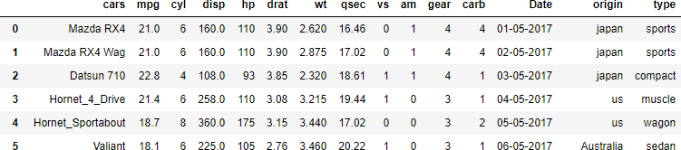
Step 03: Import the Dataset
df = pd.read_csv('mtcars.csv') df

Slide 70
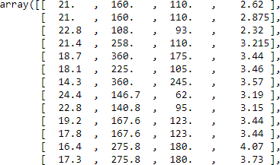
Step 04: Define x and y Variable
x = df.ix[:,(1,3,4,6)].values x
y = df.ix[:,(9)].values y

Slide 71
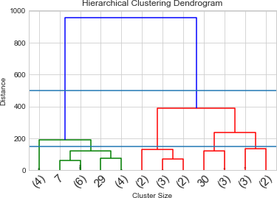
Step 05: Define a Linkage Method & Dendrogram
z = linkage(x,'ward') dendrogram (z, truncate_mode
='lastp', p = 12, leaf_rotation = 45., leaf_font_size = 15., show_contracted = True)
plt.title ('Hierarchical Clustering Dendrogram')
plt.xlabel('Cluster Size') plt.ylabel('Distance')
plt.axhline(y=500) plt.axhline(y=150) plt.show()
From the dendrogram, you can infer the number of clusters as 2 (k = 2) for fitting your data

Slide 72
Step 06: Define & Fit the Hierarchical Clustering Model
k = 2
Hclustering = AgglomerativeClustering(n_clusters = k, affinity =
'euclidean', linkage = 'ward') Hclustering.fit(x)

Slide 73
Step 07: Check Accuracy of your Clustering Technique
sm.accuracy_score(y, Hclustering.labels_)

Slide 74

Summary
In this module, you should have learnt:
Association & Dépendance
Causation & Corrélation
Covariance
Simpsons Paradox
Clustering Techniques

Slide 75


Congratulation
Probability & Statistics
for Data Science
You have successfully completed –
Data Clustering Session

Slide 76





Next Topic, We will see the
Regression Modelling
Okay, I clearly understand the Data Clustering
What Next?

Slide 77



Slide 78


Slide 79


Slide 80


